Slide 1
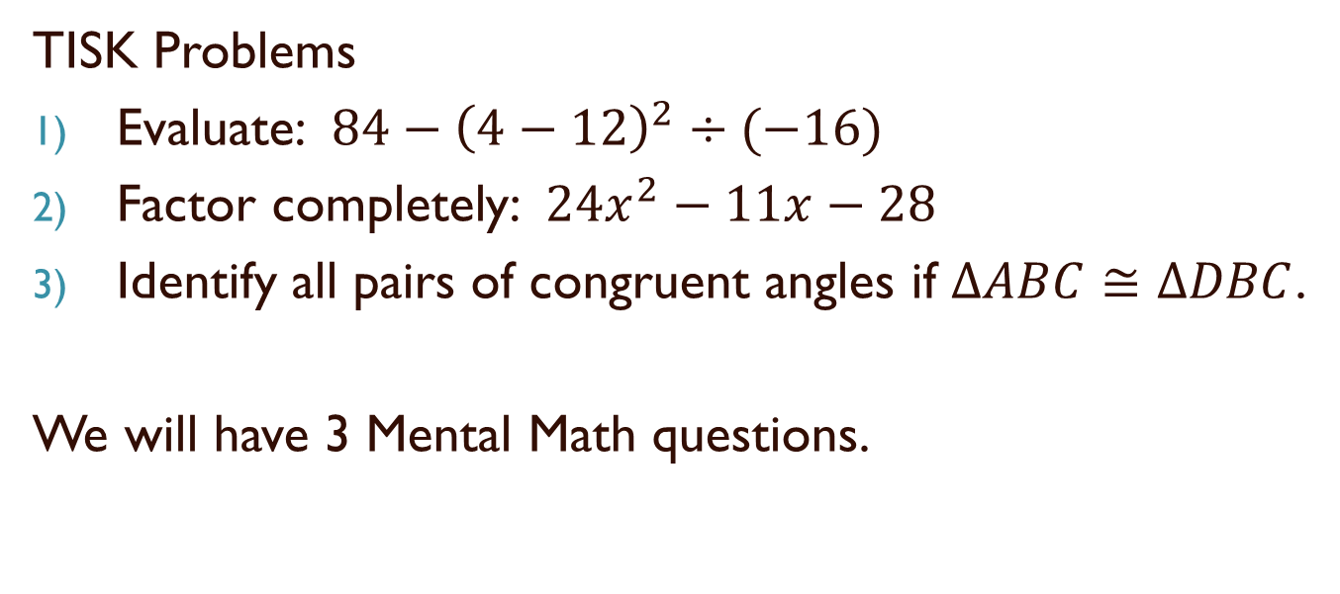
Friday, November 2, 2012
TISK Problems
Evaluate: $84−{\left(4−12\right)}^{2}÷(−16)$
Factor completely: $24x^{2}−11x−28$
Identify all pairs of congruent angles if $ΔABC≅ΔDBC$.
We will have 3 Mental Math questions.
A
C
D
B
HOMEWORK: 5-3 Worksheet
Notes:
Mental Math
1) Start with the first perfect square greater than 50. Divide by 4. Take the negative square root. Multiply by -8. (32)
2) Start with the first perfect square greater than 70. Divide by 3. Add 9. Take the negative square root. Multiply by -8. (48)
3) Start with the first perfect square greater than 120. Divide by 6. Add 5 squared. Take the negative square root. Multiply by -8. (56)

Slide 2
Homework Check
1)
2)
3)
4)

Slide 3
5)
6)
7)
8)

Slide 4
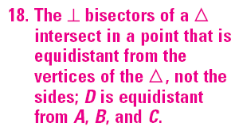
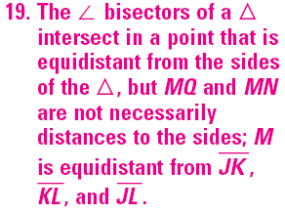
9)
10)
9)
10)

Slide 5
Medians of a Triangle
The three medians of a triangle are concurrent.
The point of concurrency of the medians is called the centroid.
centroid

Slide 6



Concurrency of Medians of a Triangle Theorem
The centroid is two thirds of the distance from each vertex to the midpoint of the opposite side.
$$AP =\frac{2}{3}AD$$
B
$$BP =\frac{2}{3}BF$$
E
D
P
C
$$CP =\frac{2}{3}CE$$
A
F
Note: The centroid can be used to balance a triangle.

Slide 7
Altitudes
Altitudes of a triangle are concurrent.
The point of concurrency is called the orthocenter of the triangle.
orthocenter
Orthocenters may occur:
Inside the triangle (acute triangles).
Outside the triangle (obtuse triangles).
Or ON the triangle (right triangles).

Slide 8
Altitudes
Altitudes of a triangle are concurrent.
The point of concurrency is called the orthocenter of the triangle.
orthocenter
Orthocenters may occur:
Inside the triangle (acute triangles).
Outside the triangle (obtuse triangles).
Or ON the triangle (right triangles).

Slide 9
Altitudes
Altitudes of a triangle are concurrent.
The point of concurrency is called the orthocenter of the triangle.
orthocenter
Orthocenters may occur:
Inside the triangle (acute triangles).
Outside the triangle (obtuse triangles).
Or ON the triangle (right triangles).

Slide 10
Concurrency of Altitudes of a Triangle Theorem
The lines containing the altitudes of a triangle are concurrent.
(Not really much of a theorem, just states that Yes, indeed, altitudes are concurrent!)

Slide 11
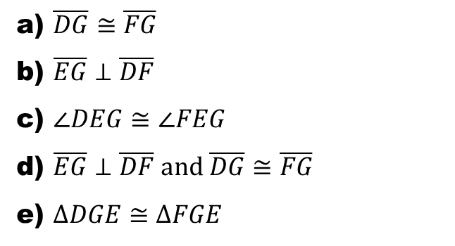
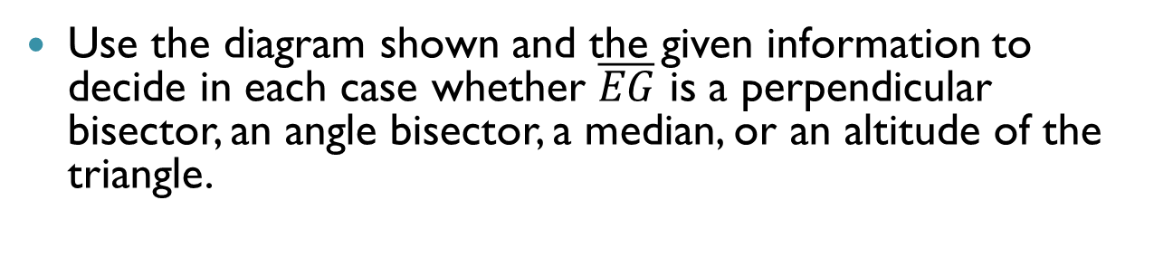
Check Points
Use the diagram shown and the given information to decide in each case whether $\overline{EG}$ is a perpendicular bisector, an angle bisector, a median, or an altitude of the triangle.
E
GIVEN:
a) $\overline{DG}≅\overline{FG}$
b) $\overline{EG}⊥\overline{DF}$
c) $∠DEG≅∠FEG$
d) $\overline{EG}⊥\overline{DF} and \overline{DG}≅\overline{FG}$
e) $ΔDGE≅ΔFGE$
D
G
F

Slide 12
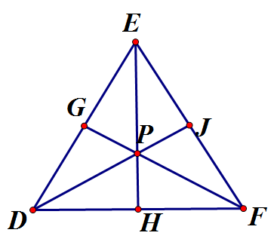


Check Points
P is the centroid of $ΔDEF$, $\overline{EH}⊥\overline{DF}$, DH = 9, DG = 7.5, EP = 8, and DE = FE.
Find FH.
Find EH.
Find PH.
Find the perimeter of $ΔDEF$
8
7.5
9

Slide 13
Next Week…
Monday: Chapter 4 Test
There will be proofs!
Tuesday: Chapter 5 Quiz 1
No Proofs!
How will you spend your weekend study time?
Option A: Study for Chapter 4 Test. (Finish 5-3 worksheet on Monday night and/or attend tutoring on Monday after school to talk about Chapter 5.)
Option B: Finish 5-3 Worksheet. (Study for Quiz 1 on Monday night and/or come to tutoring Monday to ask questions about Chapter 5.)

